Slide 1



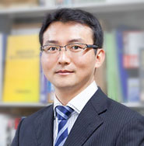

September 4, 2012 British Machine Vision Conference
Image Segmentation using Dual Distribution Matching
Tatsunori TANIAI¹
Viet-Quoc PHAM²
Keita TAKAHASHI³
Takeshi NAEMURA¹
¹: The University of Tokyo, Japan ²: Toshiba Corporate R&D Center ³: The University of Electro-Communications, Japan

Slide 2
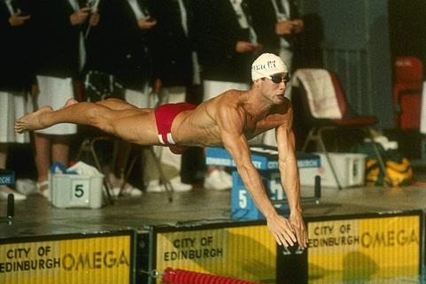
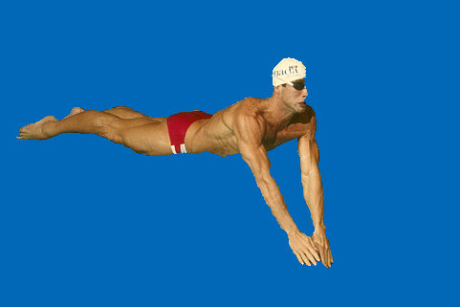


Image segmentation
Results of our method
Image
Video
Applications to image editing and object recognition

Slide 3

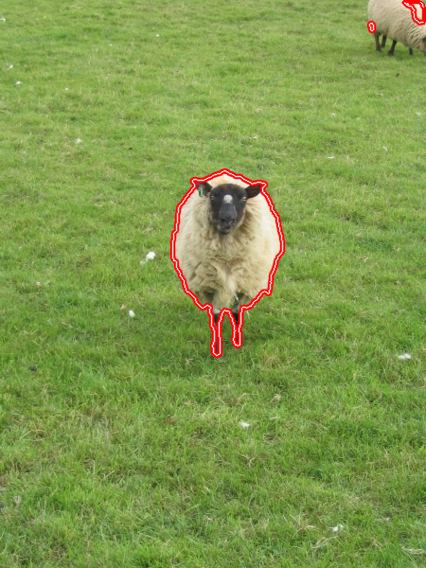
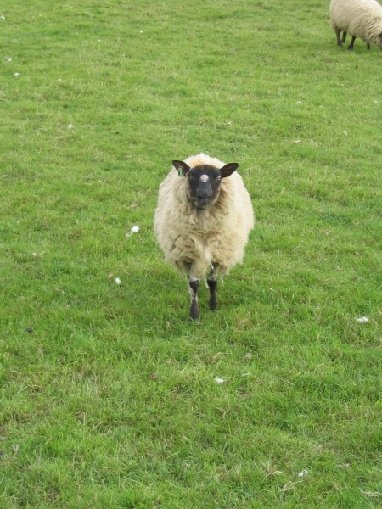






Main idea of our method
$${\text{P}}_{F}^{L}(z)$$
Input
Fg
Fg
Target image
Output
Fg matching
$${\text{H}}_{F}^{}(z)$$
Bg
Bg matching
$$L$$
$$L$$
Bg
$${\text{H}}_{B}^{}(z)$$
Input color distributions
$${\text{P}}_{B}^{L}(z)$$
Simultaneous distribution matching of Fg and Bg.
Feasible for approximate input distributions.

Slide 4

Challenges
Energy function for the resulting segmentation $L$:
Fg matching term
Bg matching term
$$\text{E}\left(L\right)=−λ_{F}\text{B}\left({\text{P}}_{F}^{L},{\text{H}}_{F}\right)−λ_{B}\text{B}\left({\text{P}}_{B}^{L},{\text{H}}_{B}\right)+λ_{S}S(L)$$
Output distribution
Input distribution
Output distribution
Input distribution
▶ Estimation of optimal weights $λ_{F}$ and $λ_{B}$ ▶ Optimization (approximate solutions to NP-hard problems)

Slide 5
Agenda
Introduction
Background and related works
Proposed method
Estimation of weights
Optimization
Experiments
Conclusion

Slide 6
Background Related works
&

Slide 7






Binary labeling & energy optimization
$$L_{p}=F$$
Pixel $p$
Fg
？
Bg
$$L_{p}=B$$
Binary labeling $L$
Assignment of Fg and Bg label
Appearance term: Measures consistencies btw the segmentation and input color info.
Smoothness term: Penalizes discontinuities btw the neighboring pixels.
$$\text{E}\left(L\right)\text{=}\text{A}\left(L\right)+λS(L)$$
The variety of segmentation methods stems from
Def. of $\text{A}\left(L\right),S(L)$ + Optimization of $\text{E}(L)$

Slide 8



Consistency measure: local & global
Appearance term
$$\text{A}(L)$$
Classify by formulation schemes of
Local measures
Global measures
$$\sum_{p∈P}{g_{p}(L_{p})}$$
$$g(L_{1},L_{2}…,L_{n})$$
Evaluate all pixels simultaneously. (high order)
Evaluate each pixel independently.

Slide 9
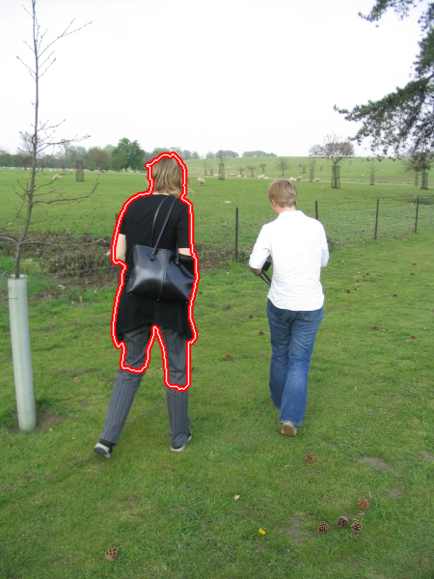
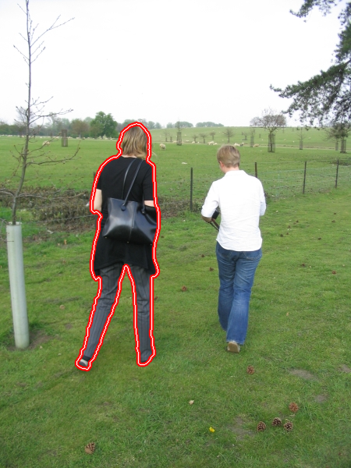





Overview of local & global measures
Local measures
Global measures
$$\sum_{p∈P}{g_{p}(L_{p})}$$
Appearance consistency
$$g(L_{1},L_{2}…,L_{n})$$
Each pixel independently
All pixels simultaneously
Easy $$\left( \begin{matrix}\text{Optimal} \text{solutions} \\ \text{via} \text{graph} \text{cuts}\end{matrix}\right)$$
Hard $$\left( \begin{matrix}\text{A}\text{pproximate} \\ \text{solutions}\end{matrix} \right)$$
Optimi- zation
High $$\left(\begin{matrix}\text{B}\text{ut} \text{rquire} \text{accurate} \\ \text{input} \text{distributions}\end{matrix}\right)$$
Accuracy
Moderate

Slide 10
Overview of local & global measures
Local measures
Global measures
$$\sum_{p∈P}{g_{p}(L_{p})}$$
Appearance consistency
$$g(L_{1},L_{2}…,L_{n})$$
Each pixel independently
All pixels simultaneously
Easy $$\left( \begin{matrix}\text{Optimal} \text{solutions} \\ \text{via} \text{graph} \text{cuts}\end{matrix}\right)$$
Hard $$\left( \begin{matrix}\text{A}\text{pproximate} \\ \text{solutions}\end{matrix} \right)$$
Optimi- zation
High $$\left(\begin{matrix}\text{B}\text{ut} \text{rquire} \text{accurate} \\ \text{input} \text{distributions}\end{matrix}\right)$$
Accuracy
Moderate

Slide 11
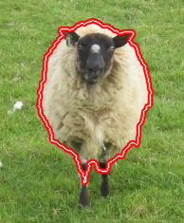

Methods based on local measures
Interactive graph cuts [Boykov et al. ICCV'01]
GrabCut [Rother et al. SIGGRAPH'04]
Fg
$$E\left(L\right)=\sum_{p∈P}{g_{p}(L_{p})}$$
$$+\sum_{(p,q)∈N}{h_{pq}(L_{p},L_{q})}$$
Unary terms
Fg-terminal
Bg
Min-Cut
Pairwise terms
Equivalent
Pixel node
Bg-terminal
Exactly optimized via graph cuts.
With simple models, the min solution prefers shorter boundaries.
⇨ Shortcut across thin structures.

Slide 12
Overview of local & global measures
Local measures
Global measures
$$\sum_{p∈P}{g_{p}(L_{p})}$$
Appearance consistency
$$g(L_{1},L_{2}…,L_{n})$$
Each pixel independently
All pixels simultaneously
Easy $$\left( \begin{matrix}\text{Optimal} \text{solutions} \\ \text{via} \text{graph} \text{cuts}\end{matrix}\right)$$
Hard $$\left( \begin{matrix}\text{A}\text{pproximate} \\ \text{solutions}\end{matrix} \right)$$
Optimi- zation
High $$\left(\begin{matrix}\text{B}\text{ut} \text{rquire} \text{accurate} \\ \text{input} \text{distributions}\end{matrix}\right)$$
Accuracy
Moderate

Slide 13





Concept of global measures
Fg distribution matching
$${\text{P}}_{F}^{L}(z)≅{\text{H}}_{F}(z)$$
INPUT
OUTPUT
$$L$$
＝
$${\text{H}}_{F}(z)$$
$${\text{P}}_{F}^{L}(z)$$
$$L$$
Fg distribution
Distribution of segmented region
Output a label
Extract a region consistent with an input dist. [BMGC method, Ayed et al. CVPR'10] etc.

Slide 14
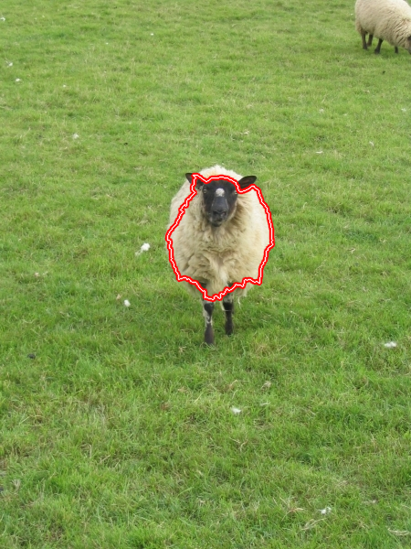

Issues on global measures
True input distribution
Approximate input dist.
INPUT
OUTPUT
INPUT
OUTPUT
GT
Approx
$${\text{H}}_{F}(z)$$
$${\text{H}}_{F}(z)$$
Accurate in detail but require an accurate input distribution.

Slide 15
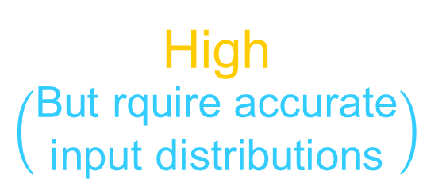
Motivation of this research
Local measures
Global measures
$$\sum_{p∈P}{g_{p}(L_{p})}$$
Goal Relax the strict assumption for input.
Appearance consistency
$$g(L_{1},L_{2}…,L_{n})$$
Each pixel independently
All pixels simultaneously
Prev Either Fg matching or Bg matching.
Ours Simultaneous matching of Fg and Bg.
Consider more information (more constraints).
Easy $$\left( \begin{matrix}\text{Optimal} \text{solutions} \\ \text{via} \text{graph} \text{cuts}\end{matrix}\right)$$
Hard $$\left( \begin{matrix}\text{A}\text{pproximate} \\ \text{solutions}\end{matrix} \right)$$
Optimi- zation
High $$\left(\begin{matrix}\text{B}\text{ut} \text{rquire} \text{accurate} \\ \text{input} \text{distributions}\end{matrix}\right)$$
Accuracy
Moderate

Slide 16
P Method
roposed

Slide 17









Proposed dual matching method
INPUT
Fg
Fg
$$L$$
$${\text{P}}_{F}^{L}(z)$$
OUTPUT
$${\text{H}}_{F}(z)$$
Fg matching
$${{\text{P}}_{F}^{L}(z) ≅\text{H}}_{F}(z)$$
Bg
Bg matching
$${{\text{P}}_{B}^{L}(z) ≅\text{H}}_{B}(z)$$
$$L$$
Bg
$${\text{H}}_{B}(z)$$
Output a label
$${\text{P}}_{B}^{L}(z)$$
$$L$$
Fg and Bg dist.
Distributions of segmented regions
Robust even for approximate input distributions

Slide 18



Proposed new energy function
$$\text{B}\left(p,q\right)=\sum_{z∈Z}{\sqrt{p\left(z\right)⋅q (z)}}$$
Bhattacharyya coef. Similarity measure of probability distributions. (Takes max 1 if $p=q$)
$$\text{E}\left(L\right)=−λ_{F}\text{B}\left({\text{P}}_{F}^{L},{\text{H}}_{F}\right)−λ_{B}\text{B}\left({\text{P}}_{B}^{L},{\text{H}}_{B}\right)+λ_{S}S(L)$$
Fg matching term
Bg matching term
More likely to capture the true solution by using dual constraints.
Challenges
▶ Estimation of optimal weights $λ_{F},λ_{B}$
▶ Optimization

Slide 19
Estimation of weights

Slide 20

Optimal weight: proportional to area size
$$−{\tilde{r}}_{F}^{L}\text{B}\left({\text{P}}_{F}^{L},{\text{H}}_{F}\right)−{\tilde{r}}_{B}^{L}\text{B}\left({\text{P}}_{B}^{L},{\text{H}}_{B}\right)$$
≒
Fg area size ratio
≒
Bg area size ratio
Fg area size
Bg area size
Image size
Image size
▶ Intuitive explanation
Simultaneous matching of Fg and Bg distributions is deeply associated with matching of the entire image distribution. Therefore, with such weights, we can implicitly enforce appearance consistency in the sense of the entire image distribution.

Slide 21
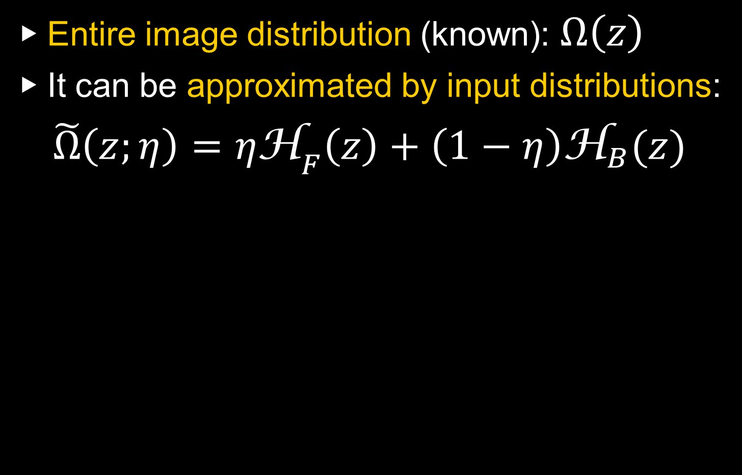

Estimation of area size ratios
▶ Entire image distribution (known): $Ω\left(z\right)$
▶ It can be approximated by input distributions:
$\tilde{Ω}\left(z;η\right)={η\text{H}}_{F}\left(z\right)+\left(1−η\right){\text{H}}_{B}(z)$
Estimate area size ratios
Find the parameter $η$ that maximizes the similarity: $$η_{F}=\arg{\max{\text{B}}}\left(\tilde{Ω}\left(η\right),Ω\right)$$
which is repeatedly updated in the optimization.

Slide 22
Optimization

Slide 23











Previous optimization method
From CVPR2010
$$\text{E}(L)≤\text{F}(L)=\sum_{p∈P}{g_{p}\left(L_{p}\right)}+λS(L)$$
Upper bound function such that graph cuts can be applied.
$${\text{F}}^{\left(1\right)}(L)$$
$${\text{F}}^{\left(2\right)}(L)$$
$${\text{F}}^{\left(3\right)}(L)$$
Optimize $\text{E}(L)$ by iteratively minimizing its upper bound functions.
$$\text{E}(L)$$
$$L$$
$$L^{\min{}}$$
$$L^{(3)}$$
$$L^{(2)}$$
$$L^{(1)}$$

Slide 24





Overview of optimization process
Upper bound of Bg term
Upper bound of Fg term
Repeat
1. Optimize Fg term
2. Optimize Bg term
3. Refine upper bound functions
4. Do segmentation
5. Refine upper bound functions
$${\text{F}}_{F}^{\left(t\right)}(L)$$
$${\text{F}}_{B}^{\left(t\right)}(L)$$
$$\text{E}(L)$$
$$L$$
$$L^{(t)}$$
Iterative graph cuts
Iterative graph cuts
Segmentation result
We approximate Fg & Bg terms by upper bound functions such that graph cuts can be applied.
A kind of alternating optimization of Fg and Bg.

Slide 25
Experiments

Slide 26


Common setup
Used GrabCut segmentation database
- consists of 50 test images
Bg
Fg
Unknown boundary
Test image
Ground truth
Trimap
C. Rother, V. Kolmogorov, A. Blake. "GrabCut: Interactive Foreground Extraction using Iterated Graph Cuts," ACM Transactions on Graphics (SIGGRAPH'04), 2004.

Slide 27
Experiment 1

Slide 28
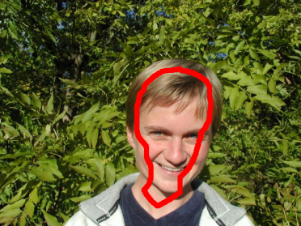
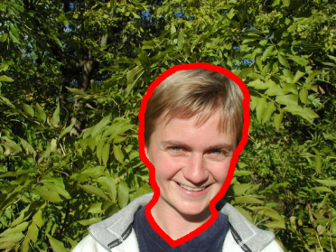
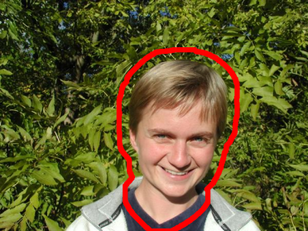

Evaluation of estimated weights
With estimated weights
Targets
$$\text{A}\left(L\right)=−{\tilde{r}}_{F}^{L}\text{B}\left({\text{P}}_{F}^{L},{\text{H}}_{F}\right)−{\tilde{r}}_{B}^{L}\text{B}\left({\text{P}}_{B}^{L},{\text{H}}_{B}\right)$$
With fixed weights
$${\text{A}}_{fixed}\left(L\right)=−0.5 \text{B}\left({\text{P}}_{F}^{L},{\text{H}}_{F}\right)−0.5 \text{B}\left({\text{P}}_{B}^{L},{\text{H}}_{B}\right)$$
Input variable
-10px
0px
+10px
$L$: we shrink and expand $L$around the GT border by -10 px to +10 px.
Fixed
${\text{H}}_{F},{\text{H}}_{B}$: approximate distributions from trimap.

Slide 29
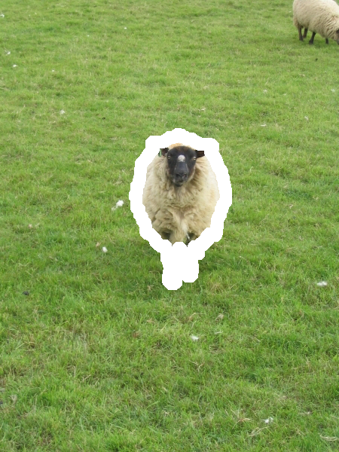



Purpose of this experiment
Fg
$${\text{=}\text{H}}_{F}(z)$$
Incomplete distributions
Bg
$${\text{=}\text{H}}_{B}(z)$$
is not referred.
Fg matching term
Bg matching term
Appearance function with proper weights.
$$\text{A}\left(L\right)$$

Slide 30

Evaluation of weight estimation
Average on 50 images.
L = Ground Truth
Fg matching
Bg matching

Slide 31
Evaluation of weight estimation
Average on 50 images.
L = Ground Truth
Proposed
Ideal form that captures the GT

Slide 32
Experiment 2

Slide 33
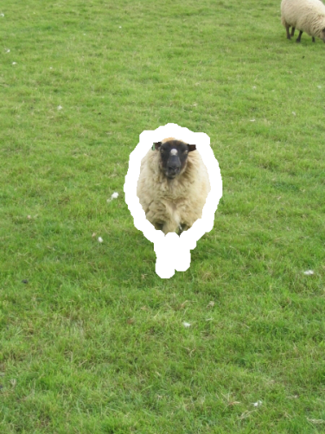

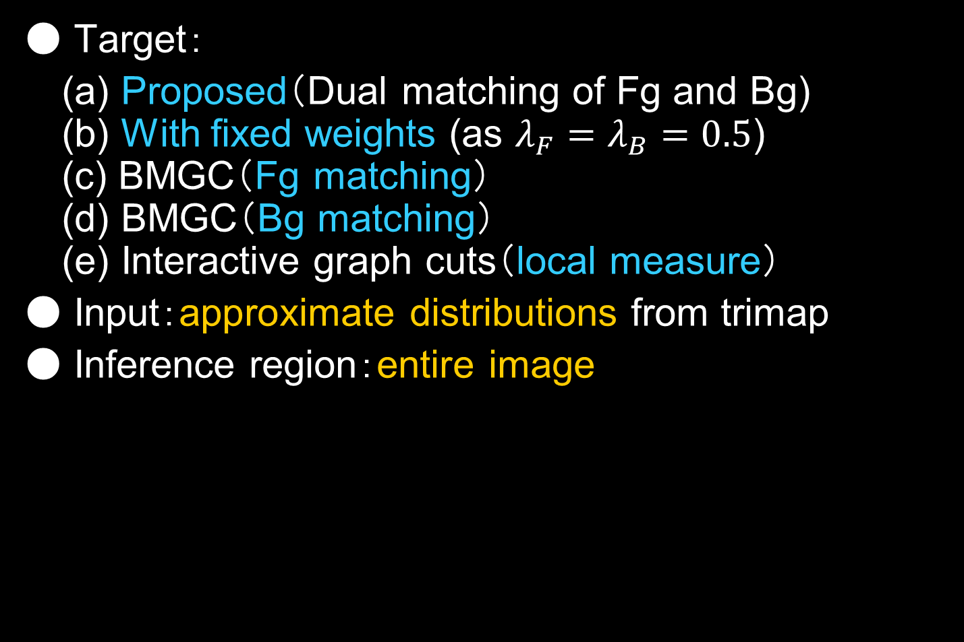


Image segmentation
● Target：
(a) Proposed（Dual matching of Fg and Bg) (b) With fixed weights (as $λ_{F}=λ_{B}=0.5$) (c) BMGC（Fg matching） (d) BMGC（Bg matching） (e) Interactive graph cuts（local measure）
● Input：approximate distributions from trimap
● Inference region：entire image
Previous
Fg
Infer all pixel labels using only input distributions
????????
????????
????????
????????
????????
$${\text{H}}_{F}(z)$$
Bg
$${\text{H}}_{B}(z)$$

Slide 34
Image segmentation result
※ error bars signify std dev.
▶ Our method was most accurate
▶ Estimated weights were effective

Slide 35
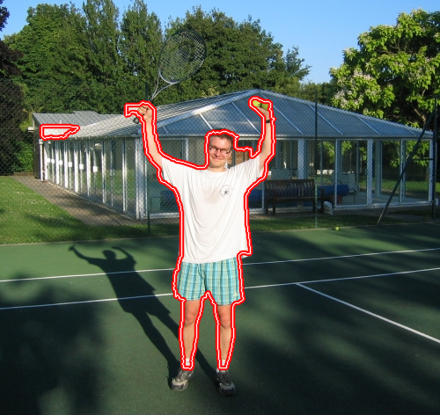
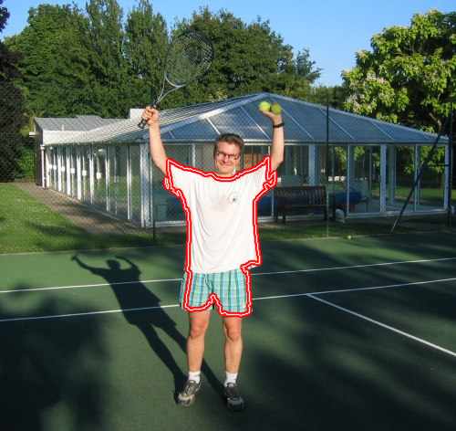
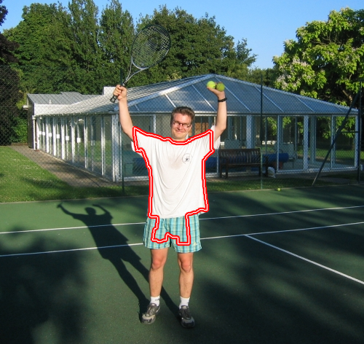



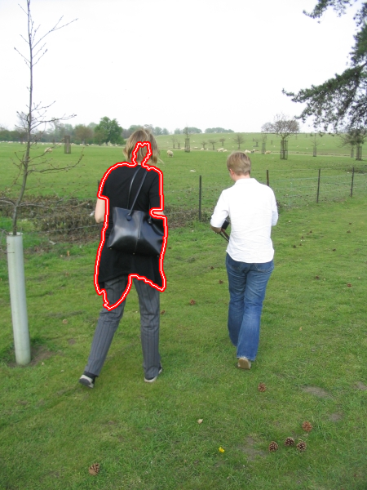



With fixed weights
Local mesurea
Proposed
Fg matching
Bg matching

Slide 36
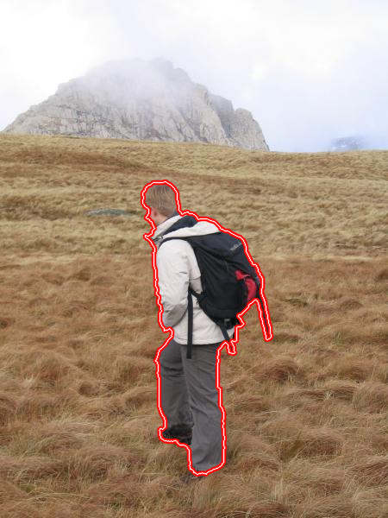
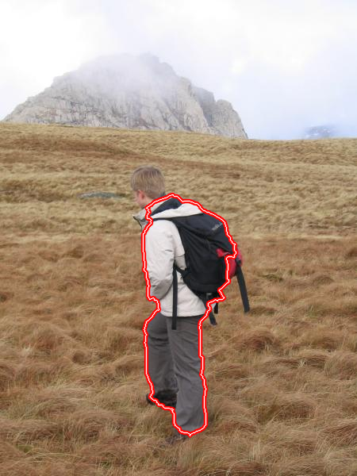


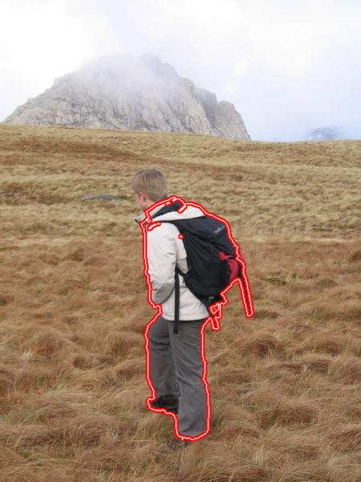
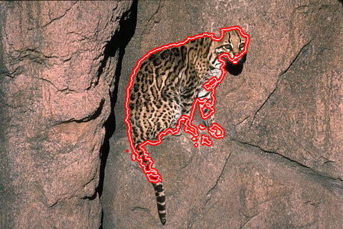
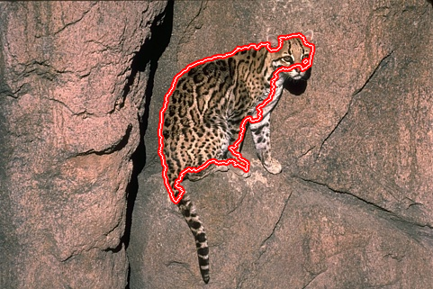
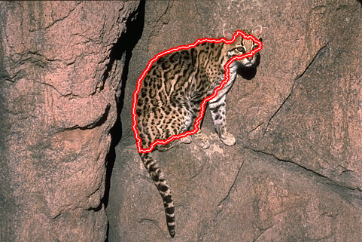
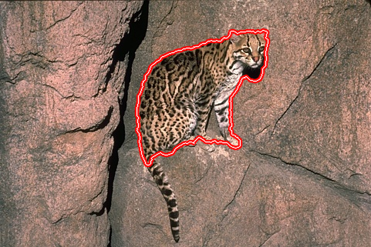

With fixed weights
Local mesurea
Proposed
Fg matching
Bg matching
Our method is relatively accurate in detail.

Slide 37
Experiment 3

Slide 38
Purpose: global vs local measures
?
Poor
Error pixel rate
Local measures
Global measures
Good
Poor
Good
Accuracy of input distributions
Vary accuracy of input distributions ⇨ Segmentation accuracy?

Slide 39
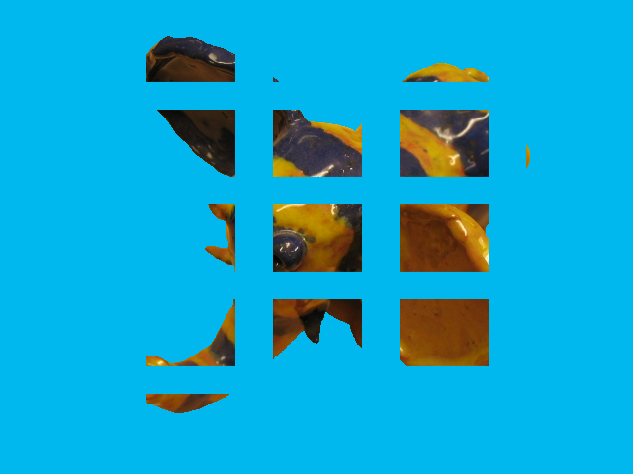
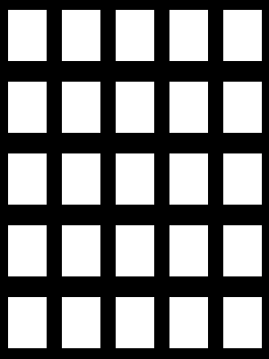
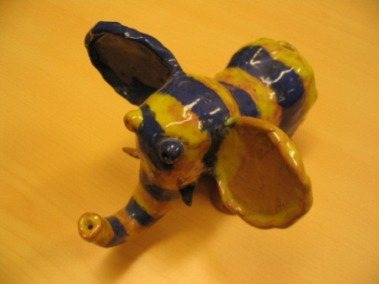



Approximate input from block masks
Masks of 5x5 blocks
Approximate distributions
Fg
$${\text{=}\text{H}}_{F}(z)$$
Reference rate 50%
Bg
$${\text{=}\text{H}}_{B}(z)$$
Only white is referred
Input distributions are made inaccurate by limiting the reference regions using masks

Slide 40
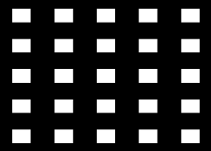
Comparison using block masks
Proposed
Most accurate at mid to high accuracies

Slide 41
Dual matching vs single matching
Fg matching
Bg matching
Proposed
Far more robust than Fg or Bg matching

Slide 42
Estimated weights vs fixed weights
With fixed weights
Proposed
Valid at almost all accuracies

Slide 43
Global measure vs local measure
Local measure
Global measure
Local measures outperform global measures if input distributions are extremely inaccurate.

Slide 44
Conclusion

Slide 45
Contributions
Proposed a dual matching segmentation method of Fg and Bg distributions with
estimated weights
a valid optimization method
Compared global & local measure methods by varying accuracy of input distributions

Slide 46
The presentation was organized as
Background & Related works
Binary labeling problem & Energy optimization
Local measures
Global measures
Proposed methods
Dual matching of Fg and Bg distributions
Estimation of weights
Optimization
Experiments
Evaluation of estimated weights
Image segmentation
Comparison of local & global measures
Any questions?
I hope you speak slooooooowly
☺

Slide 47
Experiment Extra-1

Slide 48

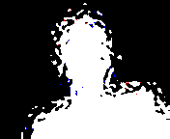


Video segmentation
● 176x144 size and 382 frames
● Input：Fg&Bg distributions from prev frames
● Inference region：entire image (did not use any motion information)
● Targets
Proposed
BMGC（Fg matching）
Interactive Graph Cuts （local measure）
$$t−1$$
$$t$$
??????????
??????????
??????????
??????????
Fg
Bg
Infer all pixels using only input distributions

Slide 49


Target Fg and Bg are dynamic
Proposed Most stable
Fg matching Prone to flickering
Local measure Significant error (shoulder)

Slide 50
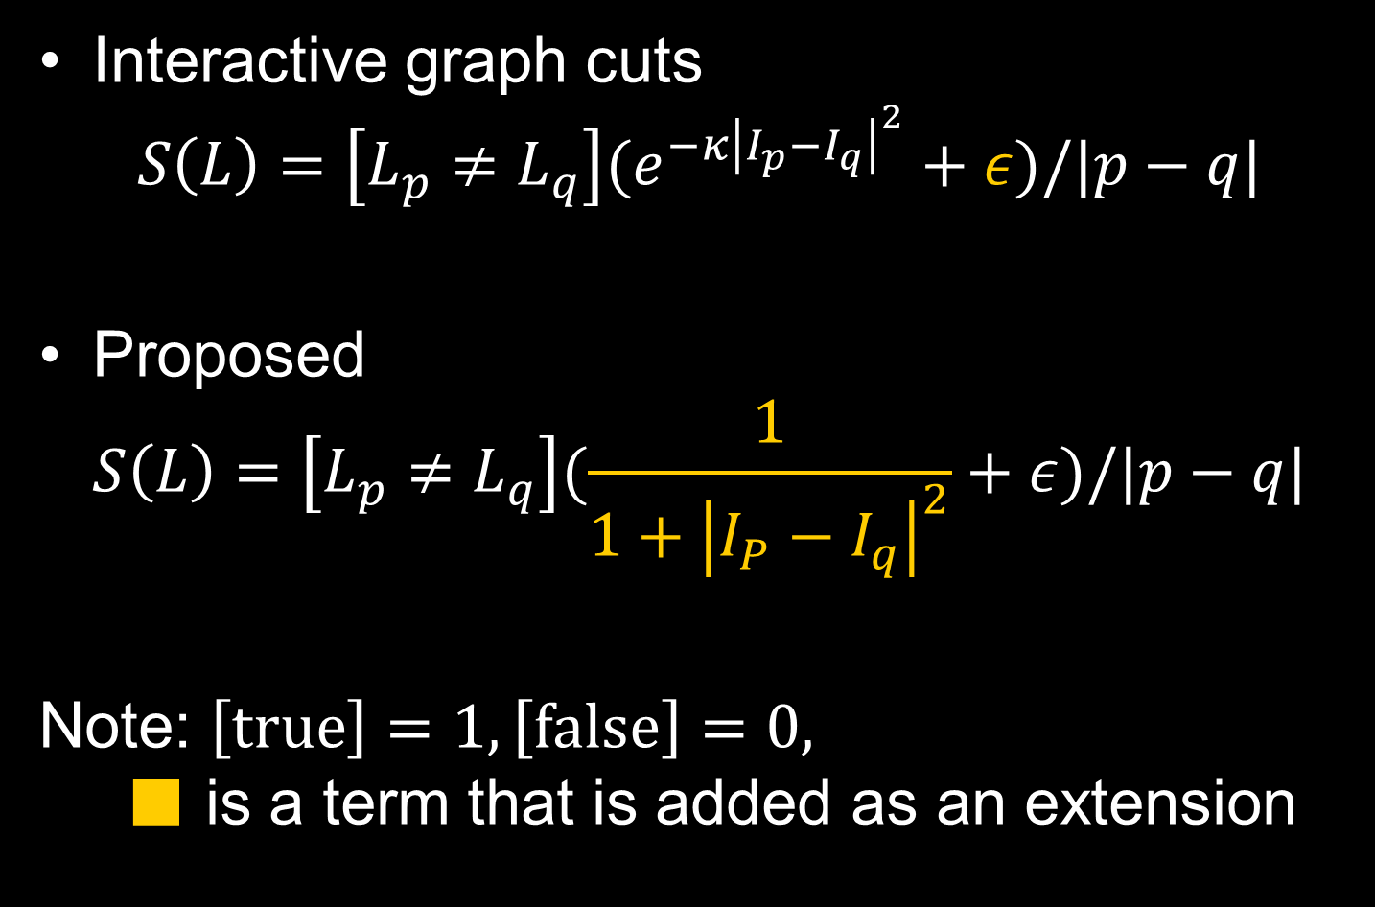
Smoothness term
Interactive graph cuts $S\left(L\right)=\left[L_{p}≠L_{q}\right](e^{−{κ\left|I_{p}−I_{q}\right|}^{2}}+ε)/|p−q|$
Proposed $S\left(L\right)=\left[L_{p}≠L_{q}\right](\frac{1}{1+{\left|I_{P}−I_{q}\right|}^{2}}+ε)/|p−q|$
Note: $\left[true\right]=1, \left[false\right]=0,$ ■ is a term that is added as an extension

Slide 51












Issue on optimizing our energy
Fg matching
Bg matching
$$\left.{\text{E}}_{F}(L\right)$$
$$\left.{\text{E}}_{B}(L\right)$$
$$L$$
$$L$$
$$L^{\min{}}$$
$$L^{(3)}$$
$$L^{(2)}$$
$$L^{(1)}$$
$$L^{(1)}$$
$$L^{(2)}$$
$$L^{(3)}$$
$$L^{\min{}}$$
Converge to opposite directions. ⇨ Cannot apply simple iterations.

